Slide 1
Commercial E2E Process
For Discussion Purposes Only

Slide 2
Objectives
Provide overview of the use cases
Show the workplan for the working sessions
Provide a blueprint for what “vendor to vendor” means
Outline the identified process changes related to each use case

Slide 3
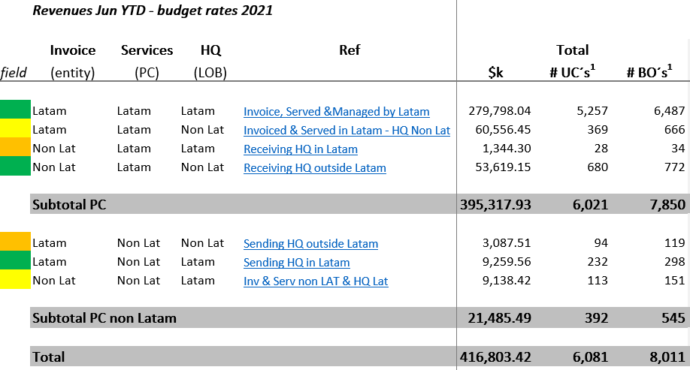
Original Use Cases | Revenue Driven (PC – Profit Center)

Slide 4
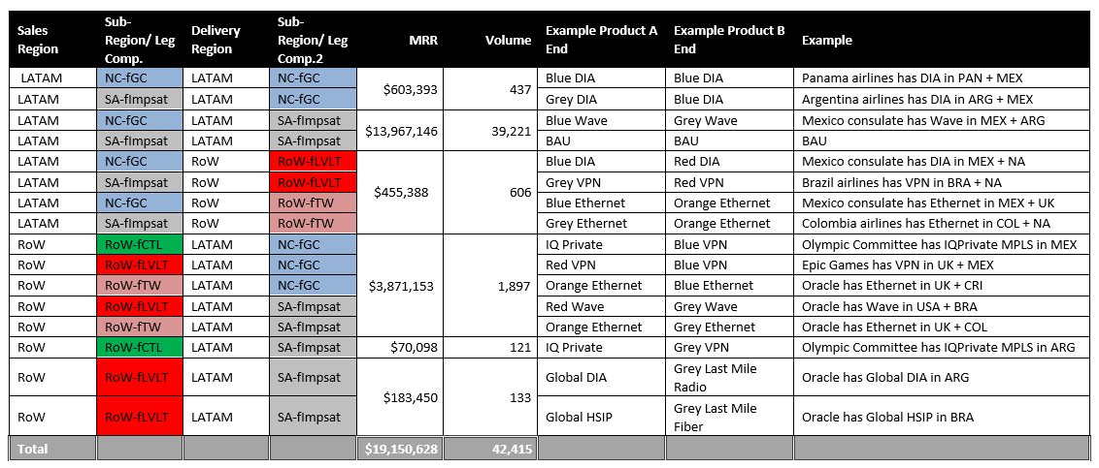
Identified Operational Use Cases
Will need to tie these use cases to the financial scenarios on the prior page
The 16 use cases below will be used to identify where process changes are required.
Product specific exceptions to be considered later

Slide 5
Use Case Scenarios and Considerations
The different scenarios will be analyzed for each of the 16 use cases on the prior page.
New Product
Interim
(Day 1+)
MACD
Product Specific Considerations
New or Existing Customer
Renewal/
Re-rate
New Product
End-State
(Day TBD)
MACD
Renewal/
Re-rate

Slide 6
Preliminary | High-Level Ruleset
Add more as discussions take place
The following high-level rules outline the vision for a Day 1 vendor to vendor model.
Product / Pricing
Ability to apply commercial revenue splits (e.g., 85/15) on existing cross-region inventory as defined by the agreements
Change events that result in a transition of existing service from 85 /15 to wholesale pricing is supported in the systems and results in correct wholesale pricing being applied
Ability to price new Logo or new Network using negotiated wholesale pricing
LATAM service cannot be modified in discounting, offer management, etc. – it follows the wholesale vendor process
Customer Hierarchy / Sales
The Customer Hierarchy for Columbus and Lumen are separate and managed independently
To obtain services from Columbus in LATAM would be a wholesale motion (not Enterprise sales teams in LATAM and RoW teaming)
Sales teams can no longer see information related to customers and services they do not own
Network
Ability to track LATAM circuits / inventory and align to specific cost centers to provide separation from other Lumen services and inventory
Cost of LATAM service, circuits, etc. is able to be classified as NetEx
Billing & Reporting
Ability to generate bi-directional billing between companies for inter-company settlement (bi-directional means that we bill Columbus independently, Columbus bills us independently – there is no integrated cred / debit methodology where we determine the net difference and bill just the difference)
Accounting is able to identify and classify costs, revenue and taxes accurately for reporting purposes
Overlay reporting is not utilized to support the above. Meaning we should put costs into the systems so there is no “math” required to figure out the cost after the fact. We should preload the correct costs up front, and the correct costs flow-through the systems
Other
If a customer disconnects a service that Lumen is paying Columbus for, or vice versa, Lumen / Columbus must notify the other vendor ASAP so we do not overcharge each other

Slide 7
Commercial | E2E Process Use Case Worskhop Calendar (October)
Monday | Tuesday | Wednesday | Thursday | Friday
27 ROW > LATAM | 28 ROW > LATAM | 29 ROW > LATAM | 30 | 1
4 | 5 Scenario Manager | 6 LATAM > ROW | 7 LATAM > ROW | 8 LATAM Holiday
11 Prep – Product (LATAM Holiday) | 12 Vyvx CDN | 13 UCC | 14 DDoS/Security CAM | 15 DIA/HSIP ROW > LATAM
18 DIA/HSIP ROW > LATAM & Parking Lot Items | 19 Modifies Main Stacks IFO/EON/SWIFT/BPMS | 20 Modifies Main Stacks IFO/EON/SWIFT/BPMS | 21 | 22
25 | 26 Disconnects Main Stacks IFO/EON/SWIFT/BPMS ROW > LATAM | 27 Disconnects Main Stacks IFO/EON/SWIFT/BPMS LATAM > ROW | 28 Existing Service Main Stacks IFO/EON/SWIFT/BPMS ROW > LATAM | 29 Existing Service Main Stacks IFO/EON/SWIFT/BPMS LATAM > ROW

Slide 8
Key Assumptions (Decisions)
Populate with key decisions as we move along
The following key assumptions (decisions) have been made during the working sessions – subject to validation and confirmation.
Latam Customer Hierarchy Team: Columbus will create their own Customer Hierarchy team to review / approve customer accounts
Wholesale Team: All orders between Columbus and Lumen will go through a wholesale team
Preferred Latam Vender: Columbus will be the “preferred” Lumen vendor in Latam for ~12 months following close
Northern Latam Cluster: The northern Latam cluster will operate in Siebel and Doku systems for new services effective at close (3/1)
Latam Terminating Orders: The international team will NOT provision on Latam equipment - Latam teams to provision on their own equipment effective at close (3/1)
Customer Care Manager (CCM) Groups: Lumen and Columbus will each have a CCM group responsible for cross-company orders

Slide 9
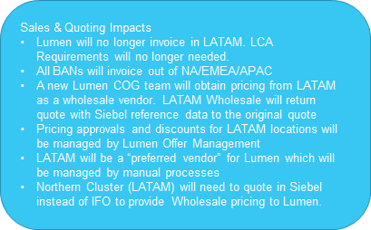
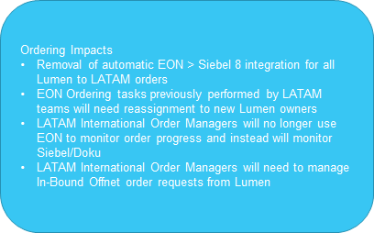
Process Impacts for ROW to LATAM with ROW Billing – New and Existing Customers with New Service

Slide 10
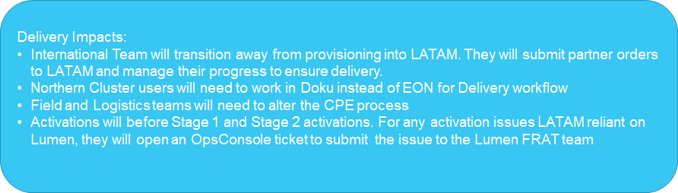
Process Impacts for ROW to LATAM with ROW Billing – New and Existing Customers with New Service

Slide 11
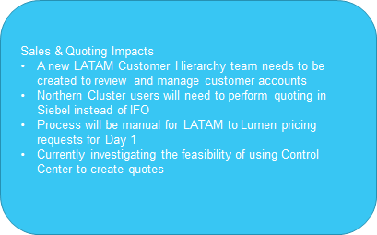
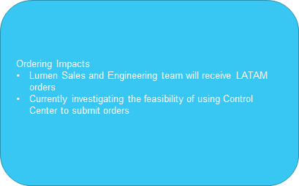
Process Impacts for LATAM to ROW with LATAM Billing – New and Existing Customers with New Service

Slide 12
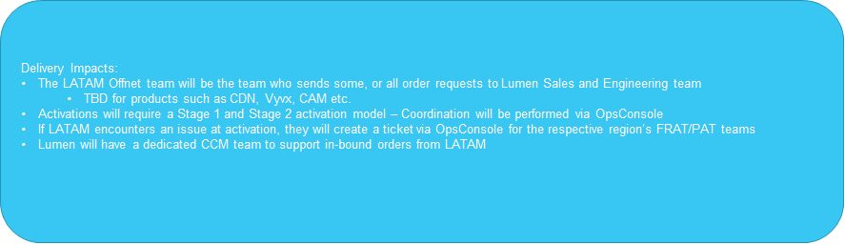
Process Impacts for LATAM to ROW with LATAM Billing – New and Existing Customers with New Service

Slide 13
Process Changes – IFO/EON ROW → LATAM (1/3)
Working Slides
Quoting
Lumen to include Columbus as a “preferred vendor” through notes or systematic rule for all LATAM locations. (can be removed?)
Within Lumen systems, LATAM locations quoted as “offnet” if Sales Region = NA Or if Sales Region = EMEA or APAC
Lumen submits SI or ROC for all LATAM locations
NA/EMEA/APAC sold ROC go to new COG team - TBD
New Lumen COG team receives SI or ROC & contacts LATAM for vendor bid – Configure new contacts/emails for LATAM Wholesale team
Need to add Columbus as new vendor
Lumen updates AMS to include Columbus vendor (for Lumen) info/pricing
LATAM team receives email from Lumen COG with product request.
LATAM creates Quote in Siebel 8
Add Northern Cluster locations/pricing into Siebel
LATAM Wholesale sends email back to Lumen COG with vendor/pricing and Siebel reference data to refer to the original Siebel quote
Ordering
Removal of automatic EON > Siebel 8 integration for all Lumen to LATAM orders - New Process: Orders will be sent via email order template to LATAM in the Offnet Ordering process
EON Ordering tasks previously performed by LATAM teams will need reassignment to new Lumen owners - New Process: Ordering tasks will need to be performed by different Lumen resources
LATAM Ordering will take Lumen In-Bound orders and submit them into Siebel

Slide 14
Process Changes – IFO/EON ROW → LATAM (2/3)
Working Slides
CCMs
LATAM International Order Manager (CCM) role and process will change to no longer use EON to monitor orders - New Process: International Order Manager (CCM) role will serve as a direct contact with Lumen CCMs (Further details of process definition required)
New Process: International Order Manager (CCM) will need to manage In-Bound Offnet order requests from Lumen Offnet Ordering team for orders, supps and also to return order details to Lumen.
Off-Net
International Team will send LATAM terminating orders to LATAM International Order Manager via email with template and any Supps requiring a provisioning change
International Team will receive order details from LATAM CCM

Slide 15
Process Changes – IFO/EON ROW → LATAM (3/3)
Working Slides
Provisioning
Short Term - LATAM Designers will use Offnet handoff details and complete design to the customer premise
Short Term - LATAM Provisioners will provide CCM the DLR (Design Layout Record) and vendor (LATAM order details - Circuit ID/Service ID/etc.
Long Term - International team will end all provisioning in LATAM and will manage Partner Ordering with LATAM
Long Term - LATAM will perform all provisioning in LATAM
Field/Logistics
Process changes required to communicate CPE requests from Lumen to LATAM
Activations
Process changes required for end to end circuit test and activation

Slide 16
Process Changes – Scenario Manager
Working Slides
Major Change – Migrated Northern Cluster to Siebel / Doku systems:
Expectation that Northern Cluster will migrate from EON to Siebel/Doku – Currently under analysis
LATAM will be treated as Offnet:
Remove/Update any automatic pricing
AMS: Update required for Columbus pricing. Pending decision on separate LATAM instance.
ROC: Submit to new COG team queue
COG submits email requests to Columbus for vendor bid. Load Columbus vendor & new email contacts.
Process will be manual for LUMEN to LATAM NewCo pricing requests for Day 1
Pricing Changes:
ProfitMax adjustments for LATAM locations – Update margin calculations
Pricing Adjustments/Discounts – LATAM will no longer access SM quote to update pricing/discounts for LATAM locations. This will go through sold region Offer Management.
Billing Changes:
Lumen will not invoice in LATAM and therefore, will need to remove LCA process & system requirements
Delivery:
Delivery teams will need to understand that all LATAM locations are Offnet, and they will need to trigger Offnet workflow in EON

Slide 17
Process Changes – LATAM--> ROW
Working Slides
Sales
A new LATAM Customer Hierarchy team will be created to review and manage customer accounts
Major Change – Migrated Northern Cluster to Siebel / Doku systems:
Northern Cluster will need to perform quoting, ordering and delivery in Siebel/Doku instead of IFO/EON
Lumen will be treated as Offnet:
AMS: Update required for Lumen pricing. Pending decision on separate LATAM instance.
Process will be manual for LATAM to Lumen NewCo pricing requests for Day 1
Investigating use of Control Center portal for LATAM to get pricing of products from Lumen
Delivery:
The LATAM Offnet team will be the team who sends some, or all order requests to Lumen Sales and Engineering team
TBD for products such as CDN, Vyvx, etc.c
Order Entry will receive LATAM order requests from Lumen Sales and Engineering or possibly Control Center (if we can submit orders to CC)
There will be a dedicated CCM for any LATAM orders – Further operational details are still required
Will need to validate any ROW Sold > LATAM Delivery system routing rules to avoid impacts
Activations will require a Stage 1 and Stage 2 activation model – Coordination will be performed via OpsConsole
If Lumen or LATAM encounters an issue at activation, they will create a ticket via OpsConsole for the respective region’s FRAT/PAT teams.

Slide 18
Owner: | Lumen - SD
User: | Columbus SD
<Functional Area> | <Process ID> Process Name
High Level Process Description and Process Flow (emphasis on areas of change)
NA-EMEA IP: Network Monitoring – “Network Element Experiences a Fault”
Network element experiences a fault
RFM detects fault
If automated ticketing enabled, OpsConsole ticket created in NA IP NOC queue
If not automated, fault displayed on RFM dashboard, NA IP NOC tech picks up and troubleshoots per BAU process
___________via XXXX
XXXXX
XXXXX
XXXX
XXXXX
XXXX
XXXXX
XXXXX Form Details:
XXX
XXX
Columbus Systems
Lumen ROW Systems
I L L U S T R A T I V E
Systems, Applications & Tools Required
Roles & Actors (Key Users)
Escalation Path & Error Handling
RFM
Ops Console
IAA/Itential
Columbus Owners:
ResCo Owners:
One combined RFM instance, or separate LATAM instance?
Autoticketing capabilities as current?
IAA/Itential, other automations available?
One combined Ops Console instance, or separate LATAM instance?
Key Assumptions (Rules of Engagement)
SLAs & Commitments
North America RFM instance has connectivity to LATAM network elements
Associated autoticketing automations like IAA need access to LATAM network
TBD
TBD
18

Slide 19
Preliminary Workplan | Timeline
The different scenarios will be analyzed for each of the 16 use cases on the prior page.
Day 1 Readiness
Day 1
Jan 1, 2022
August | September | October | November | December | Post Close
COMMERCIAL (Process Workstream)
Mobilize Commercial Workstreams / Leads
Conduct Initial Working Sessions for Priority #1
Finalize Process Change Ruleset
Finalize Ruleset
SteerCo Ruleset Review
Outline List of Process Changes
Finalize List of Process Changes
Eugenia to provide overall coordination of the process Commercial workstream with functional owners accountable for identifying and solutioning the process changes
Draft Playbook / Process Changes
Finalize Playbook
SteerCo Playbook Review
Day 1 Readiness

